Slide 1
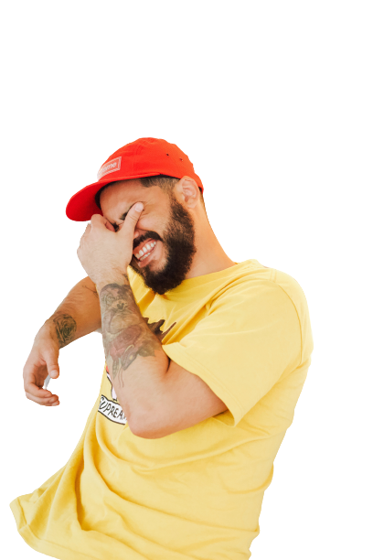
Who is the free listener in Ireland?
How are they listening?
Age breakdown
Gender
59%
22%
50%
7%
12%
50%
Top over-indexing mood
Audience social status
IE Users
Workout
Chill
Happy
ABC1
46%
+1m
80%
85%
Urban based
Listen via headphones

Slide 2
Spotify has a large, loyal audience in Ireland
+1m +20%
Monthly active free users
Increase in MAUs in 2022

Slide 3
Audio in Ireland
Digital audio listeners in IE
Spotify Free delivers the largest audience
Weekly Reach Digital Audio
Source: TGI
Source: IAB Listen Up

Slide 4
The average Spotify listener tunes in for
2.8
Hours / Day
(GWI, 2022)
Notes:
They spend, on average, 2.8 hours a day connecting by way of a wide range of devices (phones / connected TVs / Smart Speakers / Cars / PlayStations and other gaming consoles / They’re here to listen and watch their favorite creators across music and podcasts.

Slide 5
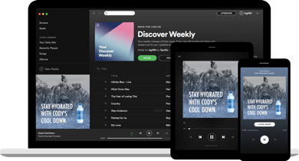
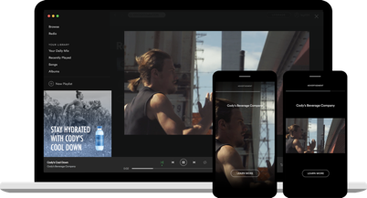
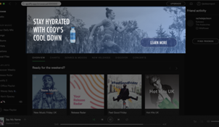
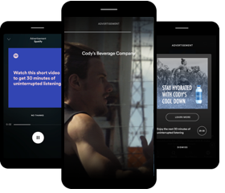
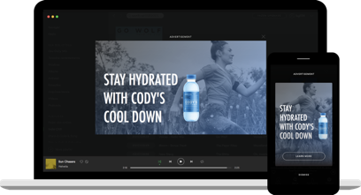
Spotify Advertising Options
Audio
Video
Display
HPTO
Audio Everywhere
Video Takeover
Sponsored Session
Overlays

Slide 6
Targeting options for a 100% logged in audience
WHO
THEY ARE
WHAT THEY’RE LISTENING TO
WHEN & HOW THEY’RE LISTENING
Age & gender Geography & language Interests & behaviours / Audience Segment
Moods, moments & mindsets
Playlist Genre Events/Cultural Moments Podcast Soon to be Available in IE
Daypart Platform
Sequential messaging
Notes:
Our targeting options are extensive. You can reach your audience based on who they are, what they’re listening to, or when and how they are listening.
Streaming sounds like – music is like a mirror - It uniquely reflects who we are, what we’re doing, and how we’re feeling - Even when we don’t share what we’re listening to publicly, it paints a picture of how we are really feeling and what we are doing in a given moment. Brands can have access to these moments and mindsets and be more relevant and contextual

Slide 7
Spotify Podcast Audience Segment
Arts & Entertainment
Business & Technology
Comedy
Education
Lifestyle & Health
Sports & Recreation
News & Politics
Society & Culture
Travellers
TV & Movies
True Crime
Target Spotify users who regularly listen to podcasts on the platform. Choose to target these listeners in general or by their favourite genre
Reach users with unskippable ads in their active listening sessions across music content
*Ads will not appear in podcasts*

Slide 8
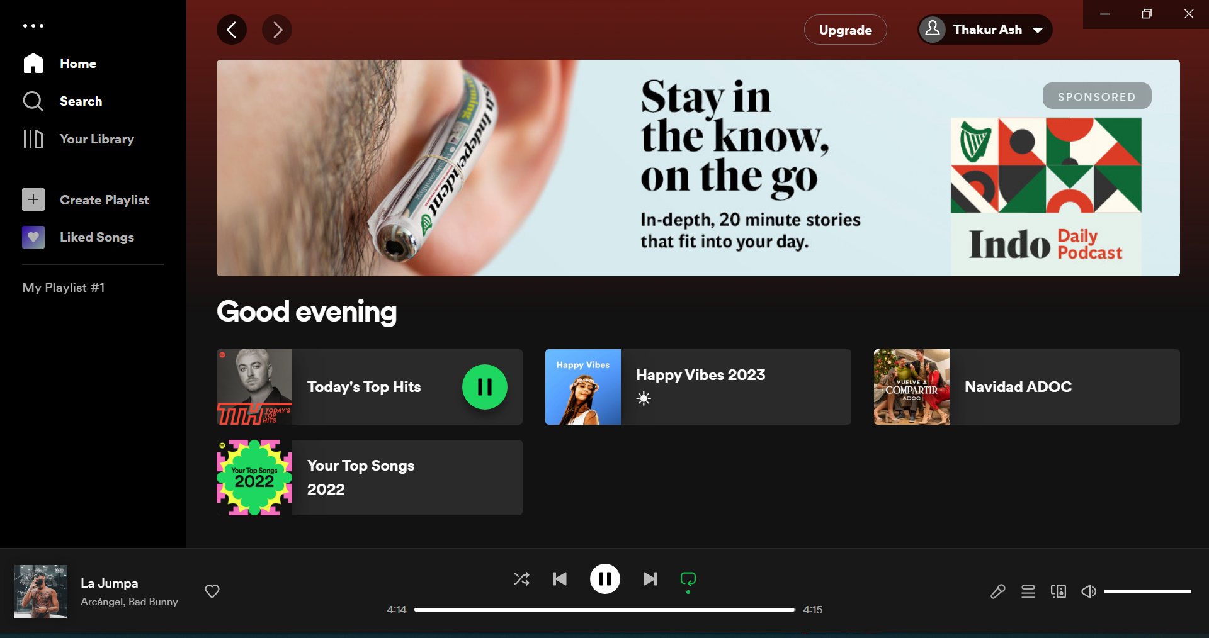
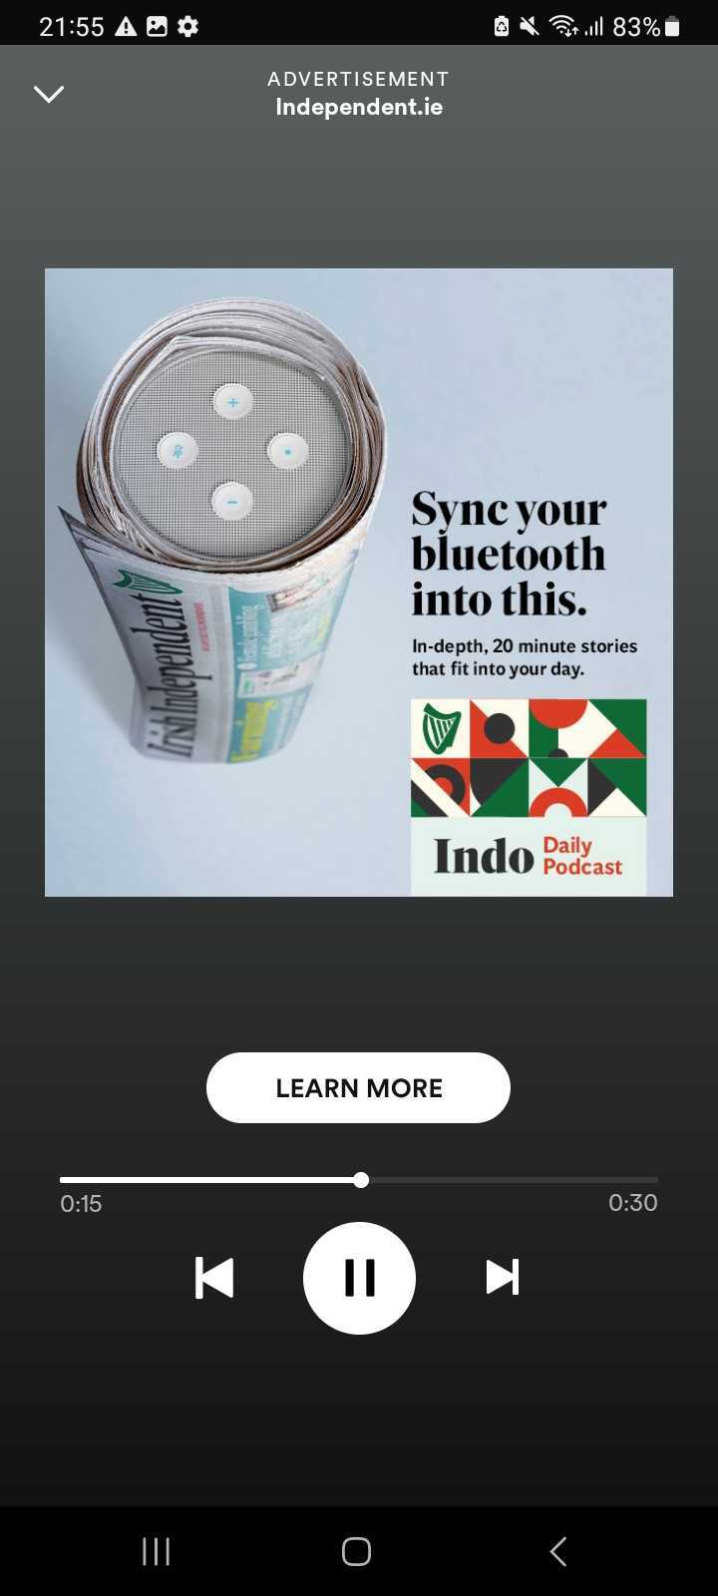
Audio Headliner and HPTO
Put your campaign on centre stage
Drive awareness and impact with our Audio Headliner + HPTO sponsorship package
Headliners are a great addition to your standard audio campaigns to drive higher reach and awareness at peak times i.e. product launches, key dates, events etc.
Your campaign will be given top priority above other ROS campaigns for 24hrs. The HPTO will give you 100% SOV of the home screen
Headliner is the best way to drive high visibility on important campaign dates and launches- the CTRs can be 3-4 times higher than average!
To protect user experience, the delivery is optimised to drive unique reach with fixed frequency caps of 2 per day, 1 per 3hr period

Slide 9
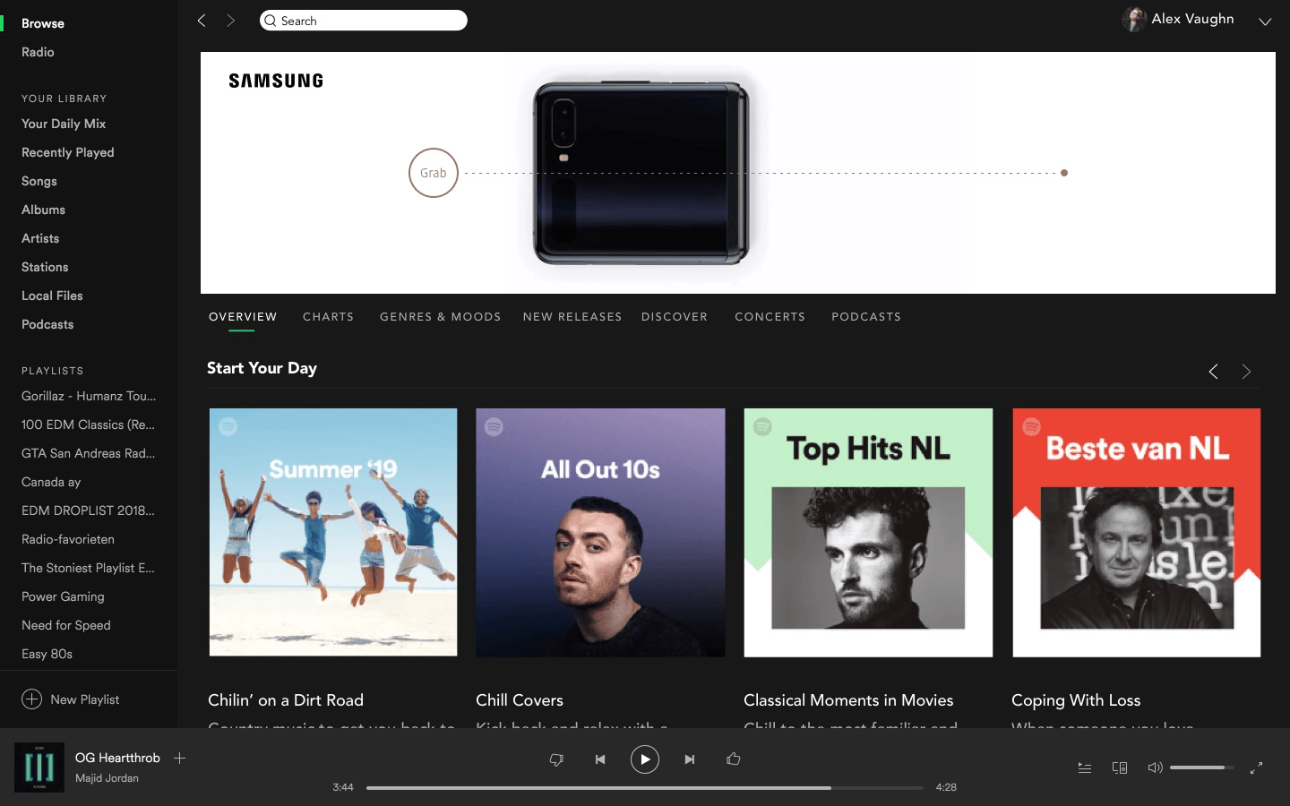
Homepage Takeover
Maximise awareness with an impactful HPTO they can’t ignore
HPTO is available on desktop, be the only brand they see when they launch Spotify
Charm the audience with a striking HPTO
Production cost will be discounted if this example is used and localised
100%
SOV, the only brand they will see on the launch page of Spotify

