Slide 1




Slide 2


The Irish Times readers and Christmas
The Irish Times has a total weekly audience of 1,523,000 adults
1,240,000 (81%) bought Christmas presents in the last 12 months,(Christmas is the most popular occasion amongst the audience for buying gifts)
479,000 of our readers plan to do most of their Christmas present shopping in-store
344,000 of our readers plan to do most of their Christmas present shopping online
382,000 of our readers plan to do their Christmas present shopping both in-store and online
All figures TGI ROI 2025 R1

Slide 3

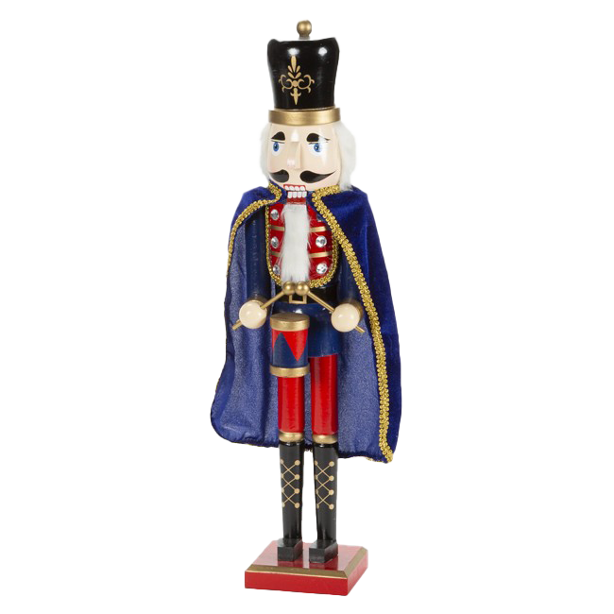
134,000
of our readers buy Christmas presents for
1-2 people
176,000
of our readers buy Christmas presents for more than
11 people
494,000
of our readers buy Christmas presents for
3- 5 people
413,000
of our readers buy Christmas presents for
6 - 10 people

Slide 4

Expenditure on Christmas presents
Our readers total expenditure on the purchase of
Christmas presents is €248,535,000
Their average expenditure on the purchase of
Christmas presents is €200

Slide 5
Types of Christmas presents
342,000 (23%) buy Tickets for events, 8% above the national average
321,000 (21%) buy Jewellery/watches, 11% above the national average
252,000 (17%) buy Technology, 16% above the national average
224,000 (15%) buy Experience days, 13% above the national average
125,000 (8%) buy Appliances, 11% above the national average
45,700 (3%) buy Charity Donations, 7% above the national average

Slide 6


‘It’s Christmas’ magazine
Published on 20th November and available with the ePaper.
A celebration of all things Christmas – gifting ideas, decoration inspiration and festive feasts. Print and digital opportunities to suit all budgets.

Slide 7
It’s Christmas Magazine
Rates and Packages
Double Page Spread: €22,000
Full Page: €12,000
Half Page: €7,500
Quarter Page: €4,500
Directory Pages (9x2): €1,000

Slide 8
It’s Christmas Magazine
It’s Christmas 2024 User Engagement Overview
HIGH READERSHIP
136,680 Irish Times readers read the It’s Christmas magazine supplement on its day of publication (51%)
DRIVING PURCHASE DECISIONS
43% of readers said they would visit advertisers featured in the magazine
69% of readers found something in the supplement of future use
Figures from Irish Times RAM reader survey Dec 2024

Slide 9


Irish Examiner Gift Guide
Publishes on Saturday 3rd December
Packed full of gift ideas from cover to cover
Double Page Spread: €17,000
Full Page: €8,500
Half Page: €4,750
Quarter Page: €2,500

Slide 10
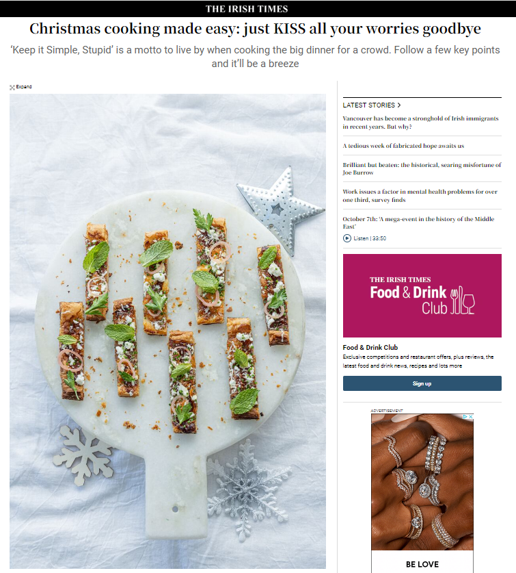
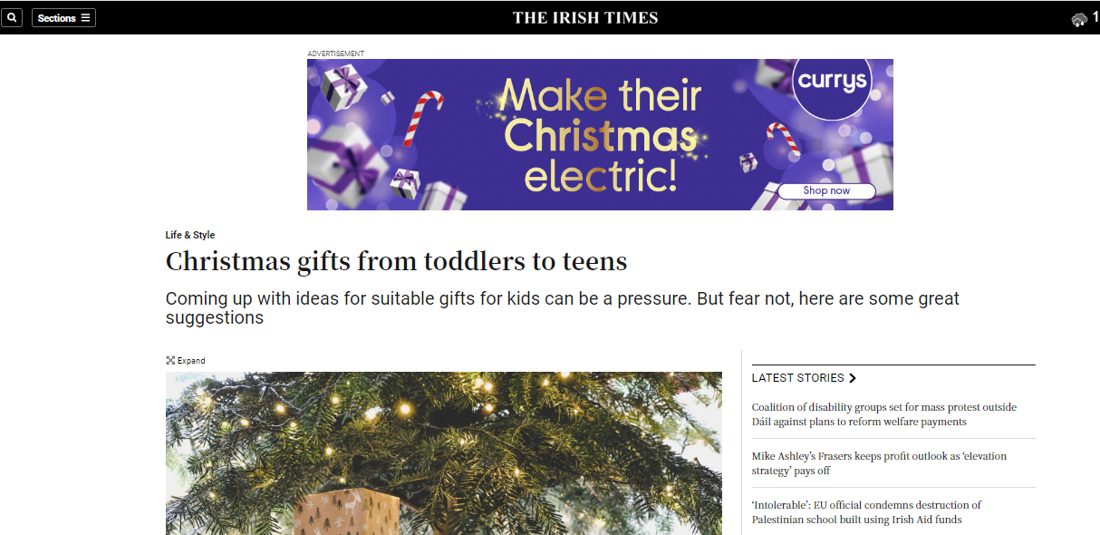
Christmas Content Takeover
on irishtimes.com
Have 100% share of voice on all our Christmas content on irishtimes.com.
From 21st November – 31st December
Guaranteed delivery of 1,500,000 impressions
Total impressions delivered 1,500,000
Total cost €10,000

Slide 11

Christmas Times Pages
To showcase Christmas gift ideas in the run up to the big day, the Irish Times will also publish a series of composite pages in the main paper throughout December. This placement is sure to offer ample coverage for festive campaigns this year.
Publication dates:
6th December
13th December
Cost: €800 plus vat (includes 30k digital ad impressions)

Slide 12




Festive Group Ad Feature
Live for 2 weeks on site Fixed teaser placement on homepage for a minimum of 2 days Fixed teaser placement on sub section for minimum of 2 days 200K imps ROS article teasers over 2 weeks ROS Article teaser at the footer of articles Facebook ad – targeting Irish Times followers and readers that are within the clients target audience. – minimum reach of 20,000 people. | Live for 2 weeks on site Native header with fixed position on IE Homepage for 24 hours​+ Teaser on sub section- 24 hours+ Native headers targeted contextually and by audience​ 200k imps ROS MPUs 2 x social posts to drive traffic to the article page​ (FB & Tw) Featured on Sponsored Dash on IE Homepage
Live for 2 weeks on site Teaser on main homepage- 24hours + Teaser on sub section- 24 hours+ Rotational MPU teasers - minimum 200,000 impressions 2x social posts (1 X Tw, 1 X FB Ad targeted to a relevant audience of a 20K users) | Live for 2 weeks on site Teaser on main homepage- 24 Hours + Teaser on sub section-, 24 hours+ ROS teaser at the footer of other sponsored articles 100k+ Imps-ROS article teasers 2x social posts to drive traffic to the article page​ Featured on Sponsored Dash on site
This Christmas, reach our extensive audience of seasonal shoppers across the Irish Times Network, with native coverage on our premium indigenous platforms- Irishtimes.com, Irish Examiner.com, BreakingNews.ie and Echo Live.ie.
Here, client-supplied content will live natively on all sites for 2 weeks in the lead up to Christmas, essentially offering a native content roadblock for maximum coverage across group platforms.
Guaranteed Views: 6,000
Total Cost: €5,000
Promotional elements as part of the campaigns are detailed opposite, per platform.

Slide 13










Seasonal Audiences
Shoppers & Gifters
Bargain Hunters
Food & Drink
Health & Fitness
Family & Parenting
Avid Home Cooks
Goggleboxers
Tech Lovers
Travel Seekers

Slide 14

Christmas Gifting Audiences
REACH
The scale of your custom Audience compared to total base
Unique Users
695.64K
13.54% of total
Weekly UU
467.99k
22.73% of total
ENGAGEMENT
How the Audience engages with content V total user base
Pageviews
29.62m
55.1% of total
Pageviews/UU
42.58
4.07x vs total
Most Active Days
Monday
& Tuesday
ACCESS TRENDS
Usage by device
Usage by domain (By PV)
Irishtimes.com 74.27%
Irishexaminer.com 11.18%
Myhome.ie 3.9%
Echolive.ie 4.5%
Breakingnews.ie 6.85%
Source: Irish Times Group Audience Solutions: Stats based on a 30 day period, Updated June 2025
Platforms: Irishtimes.com, IrishExaminer.com, BreakingNews.ie, Echolive.ie, myhome.ie
Notes:
Done & Complete- June 26th

Slide 15

Christmas Food & Drink Audiences
Unique Users
832.59K
16.26% of total
Weekly UU
531.18k
25.78% of total
Monthly Impressions
36 million
REACH
The scale of your custom Audience compared to total base
Pageviews
31.32m
58.72% of total
Pageviews/UU
37.62
3.61x vs total
Most Active Days
Tuesday & Wednesday
ENGAGEMENT
How the Audience engages with content V total user base
ACCESS TRENDS
Usage by device
Usage by domain (By PV)
Irishtimes.com 71.41%
Irishexaminer.com 13.21%
Myhome.ie 3.88%
Echolive.ie 4.61%
Breakingnews.ie 7.49%
Source: Irish Times Group Audience Solutions: Stats based on a 30 day period, Updated June 2025
Platforms: Irishtimes.com, IrishExaminer.com, BreakingNews.ie, Echolive.ie, myhome.ie
Notes:
Done- June 26th 2026

Slide 16

Festive Family & Parenting
Unique Users
176.1K
3.44% of total
Weekly UU
128k
6.21% of total
Monthly Impressions
1.1 million
REACH
The scale of your custom Audience compared to total base
Pageviews
19.33m
36.24% of total
Pageviews/UU
109.77
10.54x vs total
Most Active Days
Monday – Thursday
ENGAGEMENT
How the Audience engages with content V total user base
ACCESS TRENDS
Usage by device
Usage by domain (By PV)
Irishtimes.com 78.08%
Irishexaminer.com 11.52%
Myhome.ie 2.04%
Echolive.ie 3.41%
Breakingnews.ie 4.83%
Source: Irish Times Group Audience Solutions: Stats based on a 30 day period, Updated June 2025
Platforms: Irishtimes.com, IrishExaminer.com, BreakingNews.ie, Echolive.ie, myhome.ie
Notes:
Done- June 26th

Slide 17

Festive Movies, Books and Entertainment
Unique Users
1.55M
20.47% of total
Weekly UU
827.71k
29.49% of total
Monthly Impressions
6,5 million
REACH
The scale of your custom Audience compared to total base
Pageviews
43.16m
64.06% of total
Pageviews/UU
27.76
3.13x vs total
Most Active Days
Tuesday & Wednesday
ENGAGEMENT
How the Audience engages with content V total user base
ACCESS TRENDS
Usage by device
Usage by domain (By PV)
Irishtimes.com 66.87%
Irishexaminer.com 13.88%
Myhome.ie 4.07%
Echolive.ie 6.71%
Breakingnews.ie 8.63%
Source: Irish Times Group Audience Solutions: Stats based on a 30 day period, Updated June 2025
Platforms: Irishtimes.com, IrishExaminer.com, BreakingNews.ie, Echolive.ie, myhome.ie
Notes:
Done- June 26th

Slide 18

New Year Travel Seekers
Unique Users
359K
7.01% of total
Weekly UU
202.33k
9.82% of total
Monthly Impressions
2.8 million
REACH
The scale of your custom Audience compared to total base
Pageviews
20.43m
38.3% of total
Pageviews/UU
56.9
5.46x vs total
Most Active Days
Tuesday- Thursday
ENGAGEMENT
How the Audience engages with content V total user base
ACCESS TRENDS
Usage by device
Usage by domain (By PV)
Irishtimes.com 70.76%
Irishexaminer.com 11.56%
Myhome.ie 2.17%
Echolive.ie 2.92%
Breakingnews.ie 12.06%
Source: Irish Times Group Audience Solutions: Stats based on a 30 day period, Updated June 2025
Platforms: Irishtimes.com, IrishExaminer.com, BreakingNews.ie, Echolive.ie, myhome.ie
Notes:
Done- June 26th

Slide 19
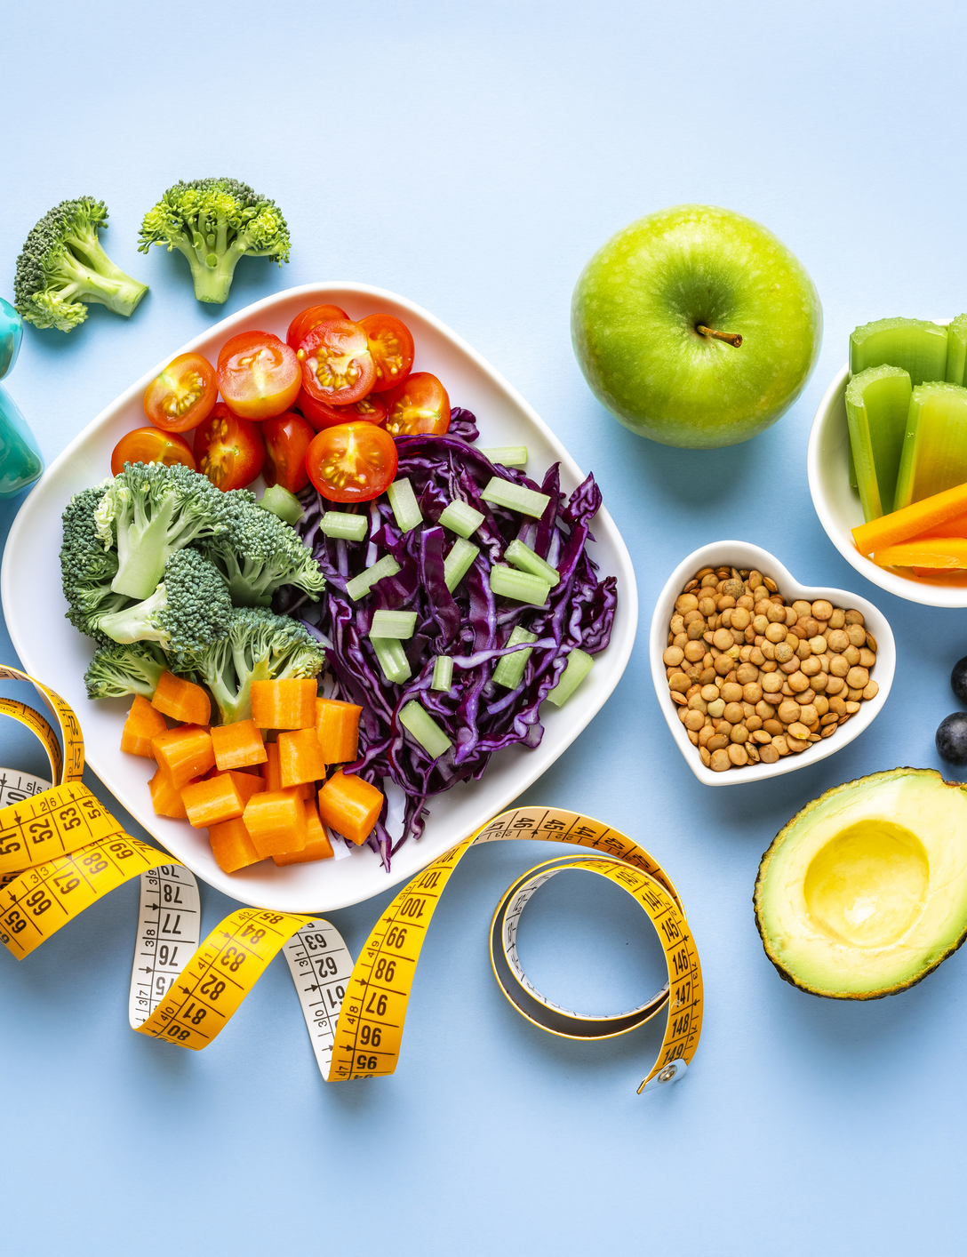
New Year Health and Fitness
Unique Users
515.32K
10.07% of total
Weekly UU
312.78k
15.18% of total
Monthly Impressions
3.5 million
REACH
The scale of your custom Audience compared to total base
Pageviews
26.35m
49.39% of total
Pageviews/UU
51.13
4.91x vs total
Most Active Days
Tuesday & Wednesday
ENGAGEMENT
How the Audience engages with content V total user base
ACCESS TRENDS
Usage by device
Usage by domain (By PV)
Irishtimes.com 74%
Irishexaminer.com 13.35%
Myhome.ie 2.49%
Echolive.ie 4%
Breakingnews.ie 5%
Source: Irish Times Group Audience Solutions: Stats based on a 30 day period, Updated June 2025
Platforms: Irishtimes.com, IrishExaminer.com, BreakingNews.ie, Echolive.ie, myhome.ie
Notes:
Done- June 26th

Slide 20
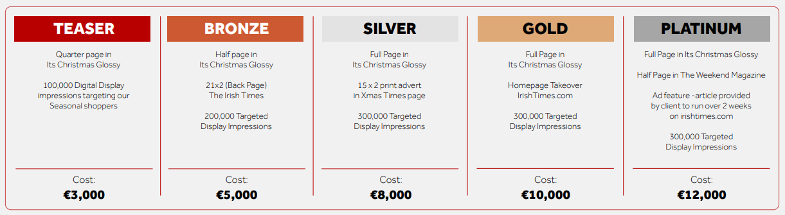
Packages

Slide 21
Thank you

