Slide 1
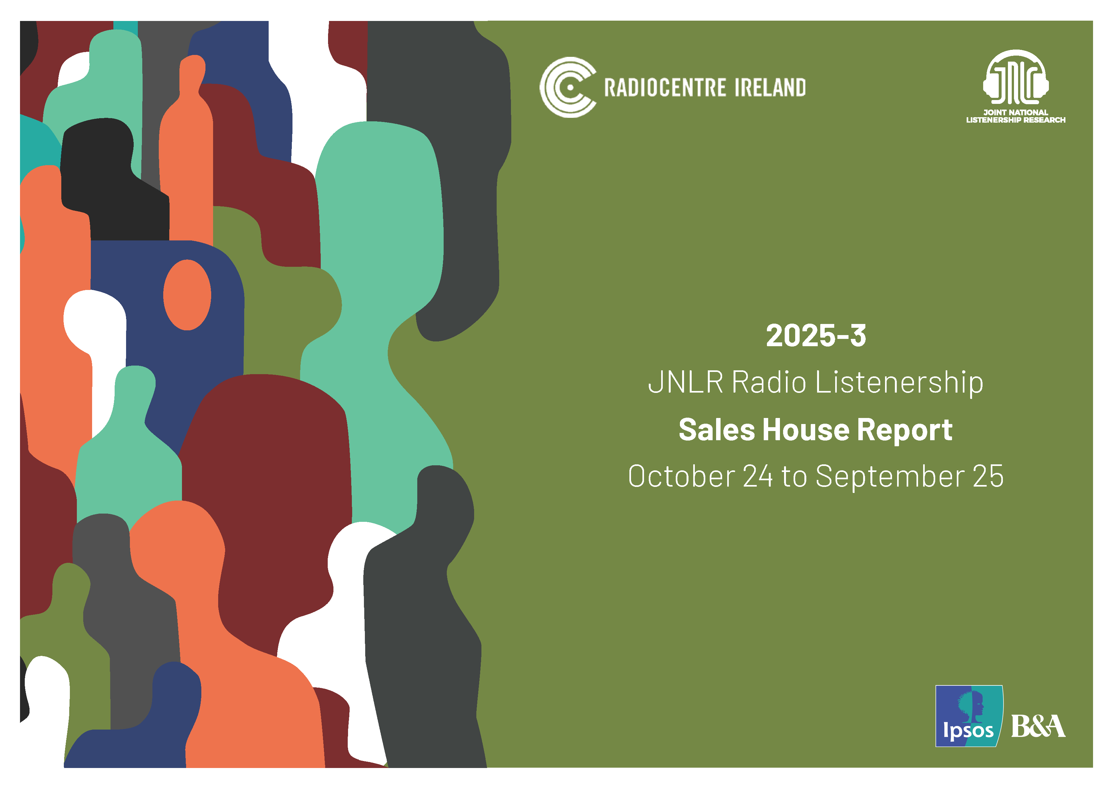

Slide 2
Note to the Reader …
The following charts outline Weekly Reach and 7am-7pm (PT) share for the 2025-3 JNLR Report.
Definitions:
In this report, the definition of ‘RTE’ has been updated to include Raidio na Gaeltachta. The data for the comparison period comprises RTE R1, RTE 2FM and RTE Lyric FM.
Universe estimates and sample size – refer to 2025-3 data.
See Appendix for Sales house composition
This report is based on the 12-month period October 2024 to September 2025. Reach data is compared, year on year, to the 2024-3 report.

Slide 3

Radio Today

Slide 4
Radio Today
Almost 3.5 million Irish adults listen to radio on an average day
PAST WEEK
DAILY
15+
15-34
35+
15+
3,481,000
911,000
2,570,000
3,979,000
On average listeners tune into 1.5 radio stations daily
Av. Mins*
239
179
261
Source: JNLR Sales House -Weekly Reach
Source: JNLR National Report 2025-3 * Average time spent among listeners 7am-midnight

Slide 5





Radio Today
While most listening happens on the AM/FM radio – 521,000 listen daily on a digital platform
Smart
Speaker
TV Set
15+
15-34
Source: JNLR Platform Data 2025-3
* Based on share of minutes 7am-midnight, to Irish stations

Slide 6
National

Slide 7
Weekly Reach – National & National Sales Houses
All Adults 000’s
National Stations
SHWK 000’s
Sales Houses
Universe: 4,402
Sample: 12,466
Universe: 1,248
Sample: 3,563
RTE definition 2025 has been updated to include Raidio na Gaeltachta

Slide 8
Weekly Reach – National & National Sales Houses
15-34 000’s
National Stations
25-44 000’s
Sales Houses
Universe: 1,353
Sample: 3,690
Universe: 1,485
Sample: 4,294
RTE definition 2025 has been updated to include Raidio na Gaeltachta

Slide 9
Weekly Reach – National & National Sales Houses
35-54 000’s
National Stations
45+ 000’s
Sales Houses
Universe: 1,584
Sample: 4,401
Universe: 2,231
Sample: 6,385
RTE definition 2025 has been updated to include Raidio na Gaeltachta

Slide 10
PT Market Share National & Sales Houses
All Adults %
National Stations
SHWK %
All Adults %
Sales Houses
SHWK %
Sample: 9,734
Sample: 2,821
RTE definition 2025 has been updated to include Raidio na Gaeltachta

Slide 11
PT Market Share National & Sales Houses
15-34 %
National Stations
25-44 %
15-34 %
Sales Houses
25-44 %
Sample: 2,473
Sample: 3,206
RTE definition 2025 has been updated to include Raidio na Gaeltachta

Slide 12
PT Market Share National & Sales Houses
35-54 %
National Stations
45+ %
35-54 %
Sales Houses
45+ %
Sample: 3,480
Sample: 5,419
RTE definition 2025 has been updated to include Raidio na Gaeltachta

Slide 13
Dublin

Slide 14
Weekly Reach – Dublin & Dublin Sales Houses
All Adults 000’s
Dublin Stations
SHWK 000’s
Sales Houses
Universe: 1,266
Sample: 2,978
Universe: 364
Sample: 837
RTE definition 2025 has been updated to include Raidio na Gaeltachta

Slide 15
Weekly Reach – Dublin & Dublin Sales Houses
15-34 000’s
Dublin Stations
25-44 000’s
Sales Houses
Universe: 414
Sample: 842
Universe: 502
Sample: 1,108
RTE definition 2025 has been updated to include Raidio na Gaeltachta

Slide 16
Weekly Reach – Dublin & Dublin Sales Houses
35-54 000’s
Dublin Stations
45+ 000’s
Sales Houses
Universe: 478
Sample: 1,102
Universe: 587
Sample: 1,520
RTE definition 2025 has been updated to include Raidio na Gaeltachta

Slide 17
PT Market Share Dublin & Sales Houses
All Adults %
Dublin Stations
SHWK %
All Adults %
Sales Houses
SHWK %
Sample: 2,185
Sample: 652
RTE definition 2025 has been updated to include Raidio na Gaeltachta

Slide 18
PT Market Share Dublin & Sales Houses
15-34 %
Dublin Stations
25-44 %
15-34 %
Sales Houses
25-44 %
Sample: 463
Sample: 780
RTE definition 2025 has been updated to include Raidio na Gaeltachta

Slide 19
PT Market Share Dublin & Sales Houses
35-54 %
Dublin Stations
45+ %
35-54 %
Sales Houses
45+ %
Sample: 853
Sample: 1,251
RTE definition 2025 has been updated to include Raidio na Gaeltachta

Slide 20
Cork

Slide 21
Weekly Reach – Cork & Cork Sales Houses
All Adults 000’s
Cork Stations
SHWK 000’s
Sales Houses
Universe: 500
Sample: 1,009
Universe: 171
Sample: 349
RTE definition 2025 has been updated to include Raidio na Gaeltachta

Slide 22
Weekly Reach – Cork & Cork Sales Houses
15-34 000’s
Cork Stations
25-44 000’s
Sales Houses
Universe: 156
Sample: 287
Universe: 165
Sample: 330
RTE definition 2025 has been updated to include Raidio na Gaeltachta

Slide 23
Weekly Reach – Cork & Cork Sales Houses
35-54 000’s
Cork Stations
45+ 000’s
Sales Houses
Universe: 176
Sample: 362
Universe: 254
Sample: 525
RTE definition 2025 has been updated to include Raidio na Gaeltachta

Slide 24
PT Market Share Cork & Sales Houses
All Adults %
Cork Stations
SHWK %
Other
Other
Cork’s RED FM
National
Cork’s 96FM
Cork’s 96FM
C103
C103
All Adults %
Sales Houses
SHWK %
Sample: 831
Sample: 282
RTE definition 2025 has been updated to include Raidio na Gaeltachta

Slide 25
PT Market Share Cork & Sales Houses
15-34 %
Cork Stations
25-44 %
Other
Cork’s RED FM
C103
15-34 %
Sales Houses
25-44 %
Sample: 224
Sample: 260
RTE definition 2025 has been updated to include Raidio na Gaeltachta

Slide 26
PT Market Share Cork & Sales Houses
35-54 %
Cork Stations
45+ %
Other
Cork’s RED FM
35-54 %
Sales Houses
45+ %
Sample: 295
Sample:453
RTE definition 2025 has been updated to include Raidio na Gaeltachta

Slide 27
Regional

Slide 28
Weekly Reach – Regional
All Adults
Universe: 2,595 Sample: 6,135 | Universe: 1,561 Sample: 3,687 | Universe: 2,379 Sample: 687 | Universe: 469 Sample: 1,845 | Universe: 845 Sample: 1,909 | Universe: 504 Sample: 1,863

Slide 29
PT Market Share Regional – 2025-3
All Adults

Slide 30
Local Area

Slide 31
Weekly Reach – Local Areas
All Adults
Uni: | 239 | Uni: | 293 | Uni: | 231 | Uni: | 184 | Uni: | 117 | Uni: | 119 | Uni: | 138 | Uni: | 120 | Uni: | 146
Sample: | 483 | Sample: | 481 | Sample: | 483 | Sample: | 483 | Sample: | 474 | Sample: | 483 | Sample: | 501 | Sample: | 473 | Sample: | 813
Uni: | 138 | Uni: | 206 | Uni: | 141 | Uni: | 110 | Uni: | 118 | Uni: | 111 | Uni: | 131 | Uni: | 94
Sample: | 483 | Sample: | 483 | Sample: | 483 | Sample: | 461 | Sample: | 459 | Sample: | 473 | Sample: | 483 | Sample: | 480

Slide 32
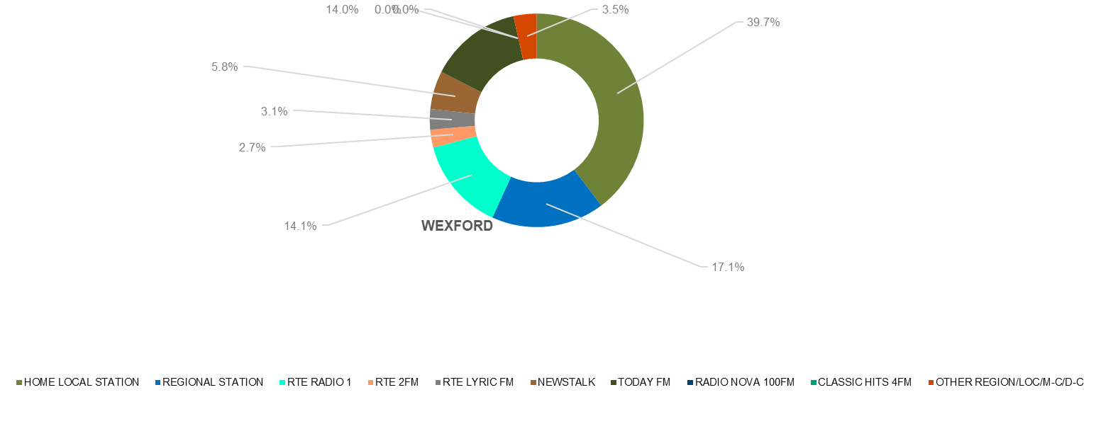
PT Share Local Areas - All Adults

Slide 33
PT Share Local Areas - All Adults

Slide 34
PT Share Local Areas - shoppers with Children
Small Sample Sizes

Slide 35
PT Share Local Areas – shoppers with Children
Small Sample Sizes

Slide 36
Radio & Social Media

Slide 37

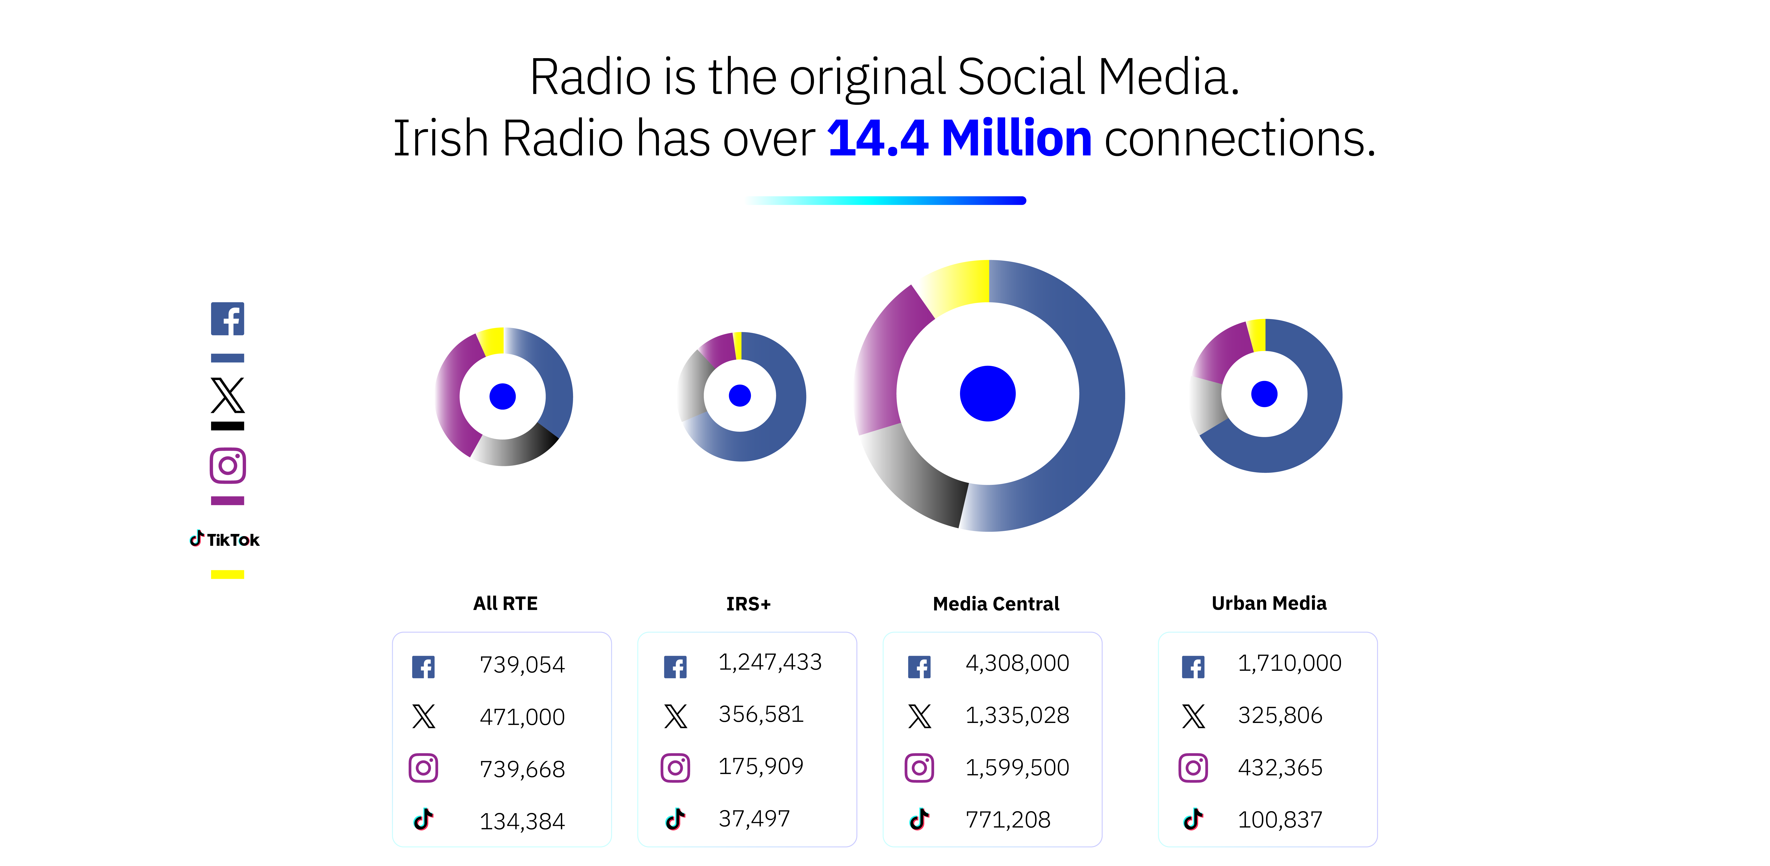

Radio is the original social media.
Irish radio has over 14.8 million connections.
All RTÉ
IRS+
Media Central
ONIC
787,970
465,390
799,200
183,730
1,301,537
357,074
202,910
49,732
4,398,000
1,580,900
1,499,069
902,191
1,478,514
279,628
410,675
131,685

Slide 38
Appendix

Slide 39
Sales House Composition
RTE
RTE Radio 1, RTE 2FM, RTE Lyric FM and Raidio na Gaeltachta
KFM, KCLR, Midlands Radio 3, South East Radio, East Coast Radio, Tipp FM, Clare FM, Radio Kerry, MWR, Shannonside, Northern Sound, Ocean FM, Highland Radio, Sunshine 106.8 and Radio Nova
Media Central Group
Today FM, Newstalk, 98FM, Spin 1038, Spin South-West, iRadio North-West, iRadio North-East, Beat 102-103, Classic Hits Radio and Red FM.
Onic Urban
IRS +
FM104, Q102, Cork’s 96FM, C103, LMFM, Live 95FM, Galway Bay FM and WLR FM

