Slide 1



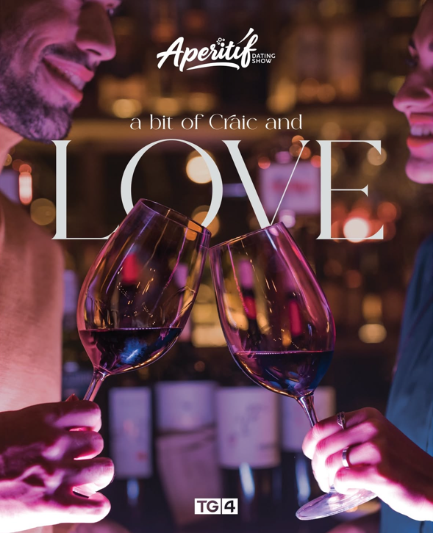
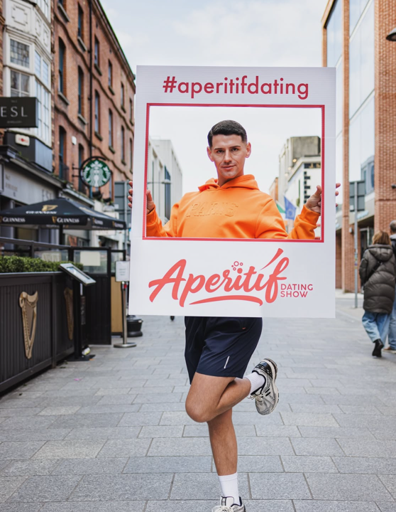
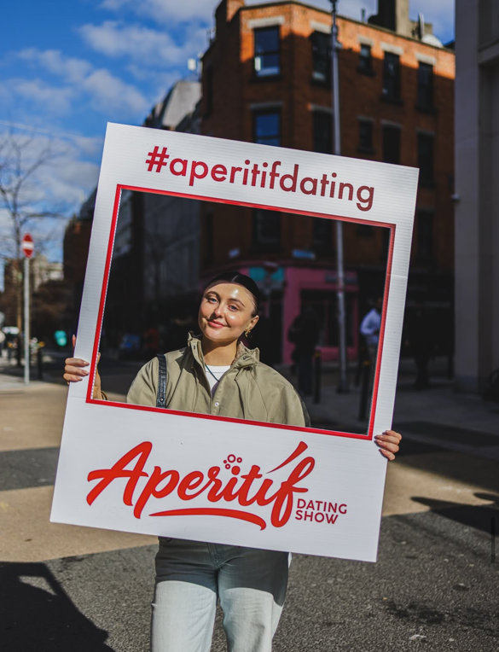
Modern dating
Aperitif
Aperitif
A new era of Irish entertainment!!

Slide 2

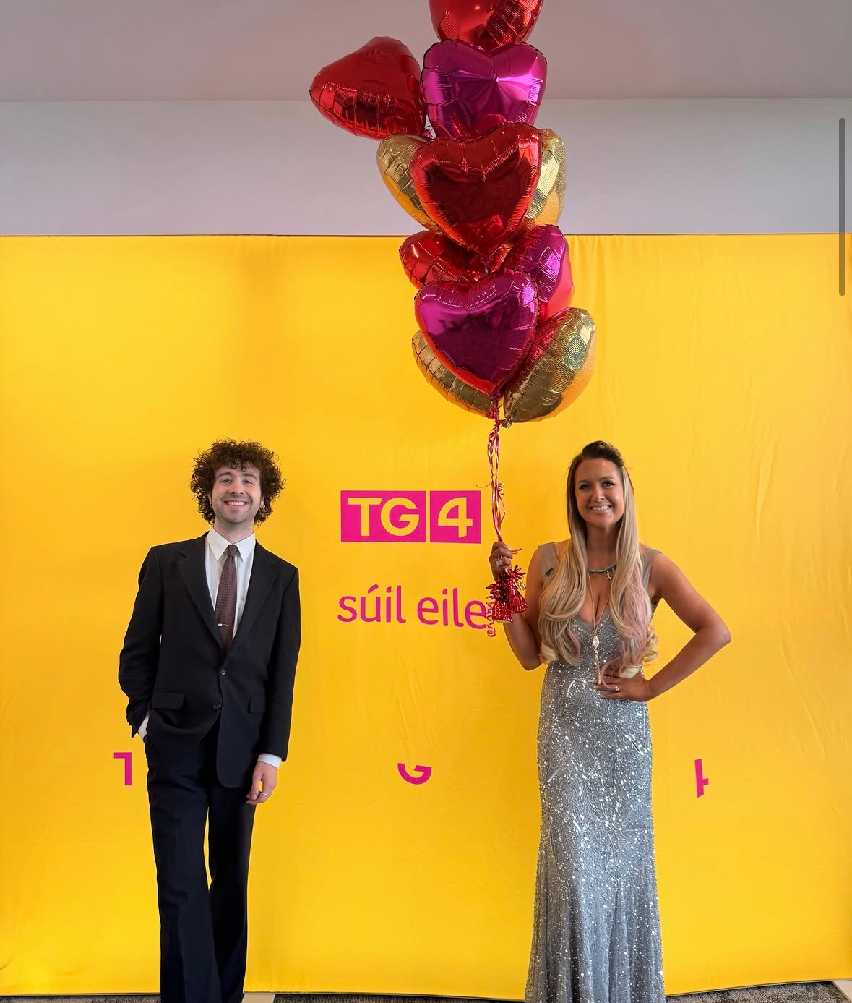
Sponsor Aperitif!
A brand- new dating show for TG4 where connection is served in 3 courses.
Three courses, three dates, one spark. Enjoy a three-course meal – a different date for each course. Aperitif- a brand-new dating show with an exciting new format airs this Autumn on TG4
The new 7-part series will air weekly *Wednesdays 2130hr, Sep 23rd & repeating Saturday @23.00
The Concept:
Instead of fast-paced app swiping, singletons enjoy a one-course-at-a-time meal where they meet three different potential matches over a three-course dinner - Starter, Mains, and Desserts
Hosts:
The series is guided by presenters Mairéad Ní Chuaig and Cúán De Búrca
Location:
Filmed at the Iveagh Garden Hotel in Dublin city centre
Language:
Adults of all ages and all proficiency levels in Irish—from complete beginners with a cúpla focal to fluent speakers.

Slide 3
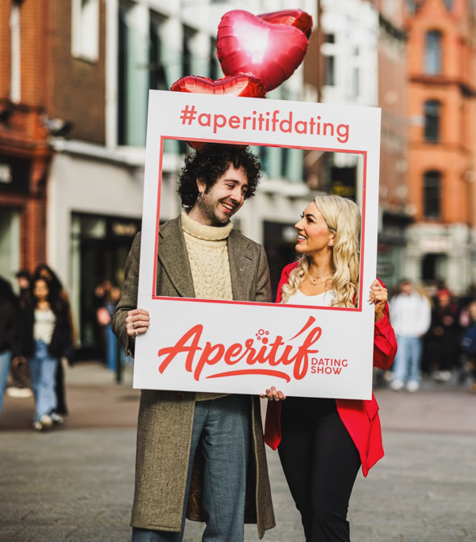
Aperitif New Series, Sponsorship Opportunity
Duration: 7 weeks – Sept 23rd
Episoides: 14 episodes including repeats
Scheduled Days: *Wednesdays at 2130hrs 23/9/2026 , repeating Saturdays @ 23:00
Break Structure: 1 Opening, 2 Centre, 1 Closing
No. of Stings: 6 per episode
Total stings: 84
Sting length: Start/End of Programme 10”
Centre Breaks 7”
Sponsor stings in Irish & English: blended approach – stings rotation in Irish and English
If OLA client – sponsor stings to be in Irish only
Adverts: 7 x 30 sec ( client to provide TVC copy & sponsor Idents/ stings) must meet station copy approval standards.
Cost per series €25,000 ex vat (including 1st repeat)

